Slide 1
Data Structure CSE-225
Dr. Mohammad Abu Yousuf
yousuf@juniv.edu

Slide 2
Array

Slide 3
Array
Array is a very basic data structure representing a group of similar elements, accessed by index. Array data structure can be effectively stored inside the computer and provides fast access to the all its elements.
Advantages
✔ No overhead per element.
✔ Any element of an array can be accessed at O(1) time by its index.

Slide 4
Array
Drawbacks:
✔ Array data structure is not completely dynamic. Many programming languages provide an opportunity to allocate arrays with arbitrary size (dynamically allocated array), but when this space is used up, a new array of greater size must be allocated and old data is copied to it.
✔ Insertion and deletion of an element in the array requires to shift O(n) elements on average, where n is size of the array.

Slide 5
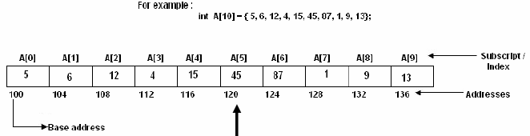

Representation of linear Array in Memory
Calculate the address of any element of an array:
w= size of the data type in the array
Base(A)= Address of the first element of the array
For example address of A[5] is:

Slide 6
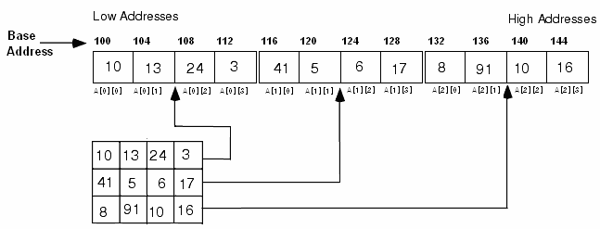
Representation of linear Array in Memory
Two-dimensional array:

Slide 7
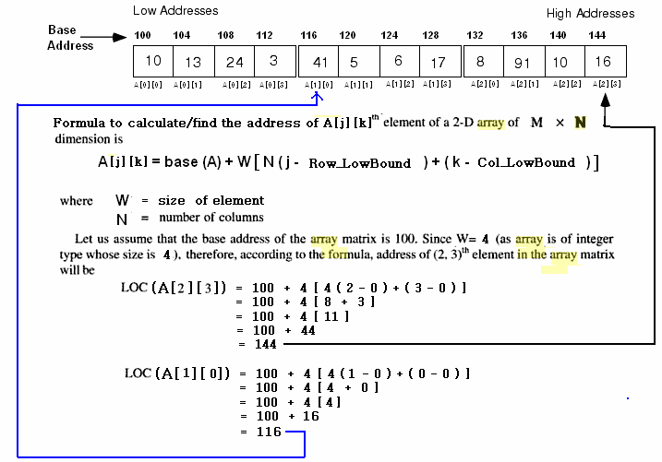

Slide 8
Operations on array
1- Traversing: means to visit all the elements of the array in an operation is called traversing.
2- Insertion: means to put values into an array
3- Deletion / Remove: to delete a value from an array.
4- Sorting: Re-arrangement of values in an array in a specific order (Ascending / Descending) is called sorting.
5- Searching: The process of finding the location of a particular element in an array is called searching. There are two popular searching techniques/mechanisms
Linear search
Binary search

Slide 9
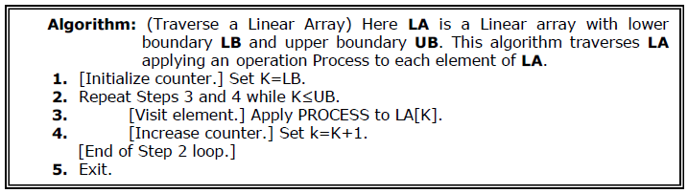
Traversing in Linear Array
It means processing or visiting each element in the array exactly once;
Let ‘A’ is an array stored in the computer’s memory. If we want to display the contents of ‘A’, it has to be traversed i.e. by accessing and processing each element of ‘A’ exactly once.

Slide 10
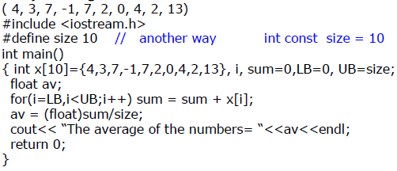
Traversing in Linear Array
This program will traverse each element of the array to calculate the sum and then calculate & print the average of the following array of integers.

Slide 11
Sorting in Linear Array
Sorting an array is the ordering the array elements in ascending (increasing - from min to max) or descending (decreasing – from max to min) order.
Example:
{2 1 5 7 4 3} →{1, 2, 3, 4, 5,7} ascending order
{2 1 5 7 4 3} →{7,5, 4, 3, 2, 1} descending order

Slide 12
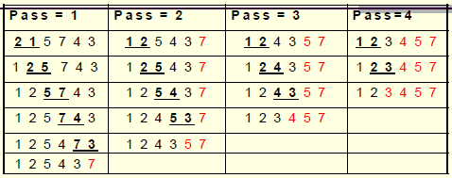
Bubble Sort
Example:
This sorting algorithm is comparison based algorithm in which each pair of adjacent elements is compared and elements are swapped if they are not in order.

Slide 13
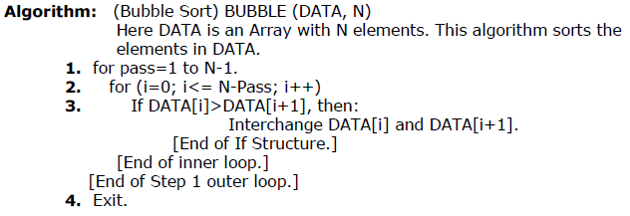
Bubble Sort
This algorithm is not suitable for large data sets as its average and worst case complexity are of O(n²) where n are no. of items.

Slide 14
#include <stdio.h>
int main()
{
int data[100],i,n,step,temp;
printf("Enter the number of elements to be sorted: ");
scanf("%d",&n);
for(i=0;i<n;++i)
{ printf("%d. Enter element: ",i+1);
scanf("%d",&data[i]);
}
for(step=1;step<n;++step)
for(i=0;i<n-step;++i)
{
if(data[i]>data[i+1])
{
temp=data[i];
data[i]=data[i+1];
data[i+1]=temp;
}
}
printf("In ascending order: ");
for(i=0;i<n;++i)
printf("%d ",data[i]);
return 0;
}
Bubblesort

Slide 15
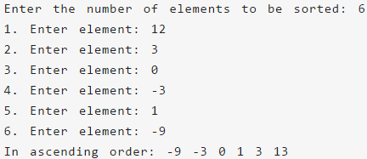
Bubble Sort
Output of previous program:

Slide 16
Complexity of bubble sort
Case 1) O(n) (Best case) This time complexity can occur if the array is already sorted, and that means that no swap occurred and only 1 iteration of n elements.
Case 2) O(n^2) (Worst case) The worst case is if the array is already sorted but in descending order.

Slide 17
Complexity of bubble sort
For an array of size n, in the worst case:
1st passage through the inner loop: n-1 comparisons and n-1 swaps
...
(n-1)st passage through the inner loop: one comparison and one swap.
All together: c ((n-1) + (n-2) + ... + 1), where c is the time required to do one comparison, one swap, check the inner loop condition and increment j.
We also spend constant time k declaring i, j, temp and initializing i. Outer loop is executed n-1 times, suppose the cost of checking the loop condition and decrementing i is c1.

Slide 18
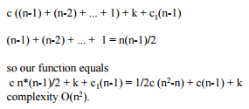
Complexity of bubble sort

Slide 19
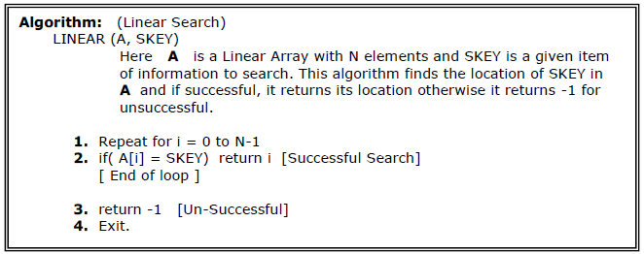
Searching in Linear Array
Linear Search:
The linear search compares each element of the array with the search key until the search key is found. To determine that a value is not in the array, the program must compare the search key to every element in the array.

Slide 20
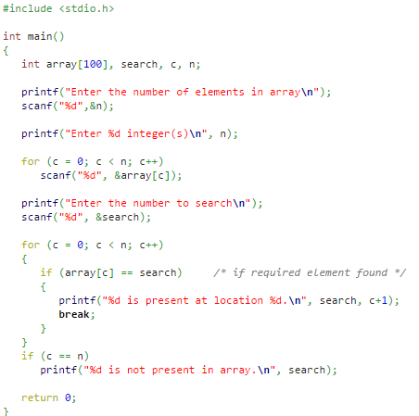
Linear search

Slide 21
Binary Search
It is useful for the large sorted arrays. The binary search algorithm can only be used with sorted array and eliminates one half of the elements in the array being searched after each comparison.

Slide 22
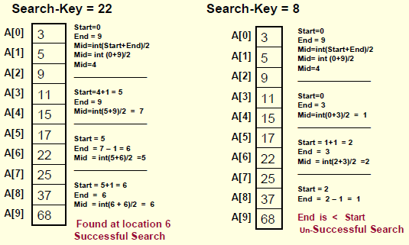
Binary Search
Example:

Slide 23
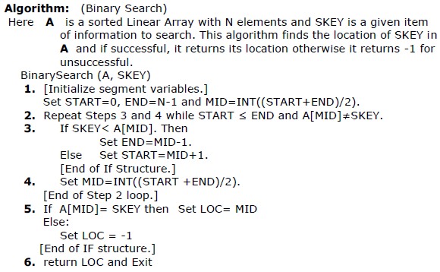

Slide 24
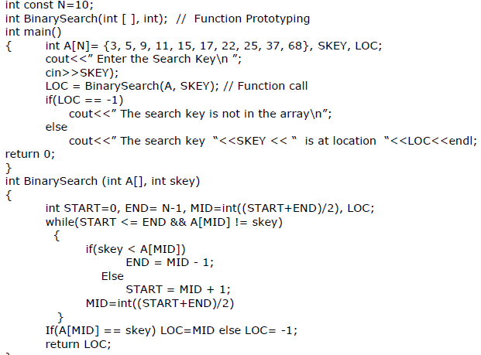

Slide 25
Computational Complexity of Linear Search
Note that the Computational Complexity of the Linear Search is the maximum number of comparisons you need to search the array. As you are visiting all the array elements in the worst case, then, the number of comparisons required is:
n-1; (n is the size of the array)
Example:
If a given an array of 1024 elements, then the maximum number of comparisons required is:
n-1 = 1023 (As many as 1023 comparisons may be required)

Slide 26
Computational Complexity of Binary Search
The Computational Complexity of the Binary Search algorithm is measured by the maximum (worst case) number of Comparisons it performs for searching operations. The searched array is divided by 2 for each comparison/iteration. Therefore, the maximum number of comparisons is measured by:
log(n); where n is the size of the array
Example:
If a given sorted array 1024 elements, then the maximum number of comparisons required is:
log(1024) = 10 (only 10 comparisons are enough)

Slide 27
Thank you

